Slide 1
VIP GROUP PRESENTATION
Zuolin Li

Slide 2
What we did:
Refractory a JS file, which defines all kinds of grid classes, into several small JS files in a “/grid” directory for GORP project.
Added a convertor function to ‘Ribbon Diagram’. This convertor converts a CSV file to JSON type file, so that the program can display a proper diagram according to the JSON data.
The last thing we did is to add a linear-chart diagram to represent the number of diagrams and users of each institution for each month in ‘Ribbon Diagram’ ”/report” directory.

Slide 3
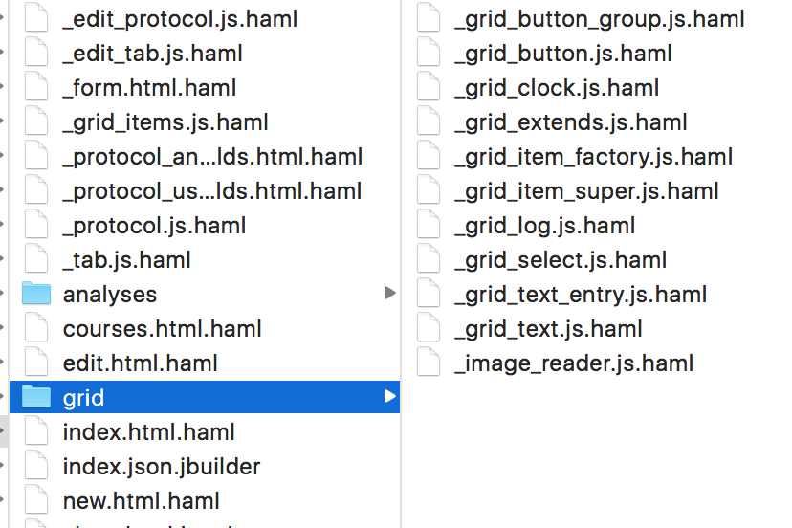
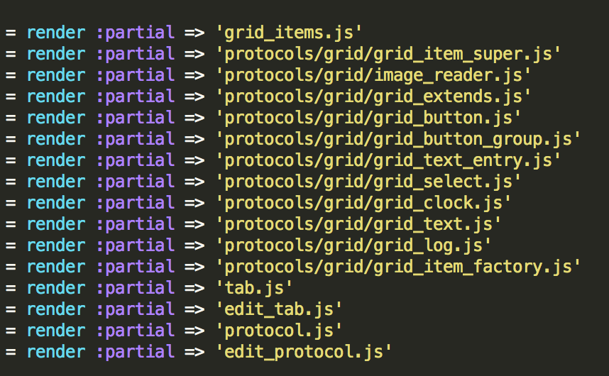
GORP:
The first task is not hard since we just split the file to separate ones, but it is a good way to get familiar with Rails application structure.
Refactor _grid_item.js.haml to serveral js.haml as below:
In the _form.html.haml, we need to render each of those files.

Slide 4
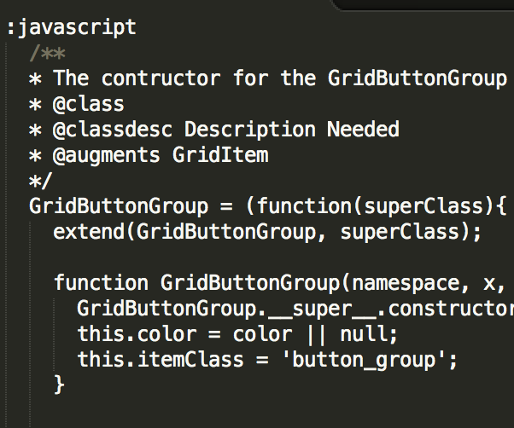
Problems:
The problems we had was that the haml format bothered me a lot at the beginning, since we were not familiar with haml. We just tried several times to find out what is the correct format.
The second problem was we were unable to render those separated files in another grid directory. We asked Matt for help, and find out we need to include the whole directory while rendering.

Slide 5
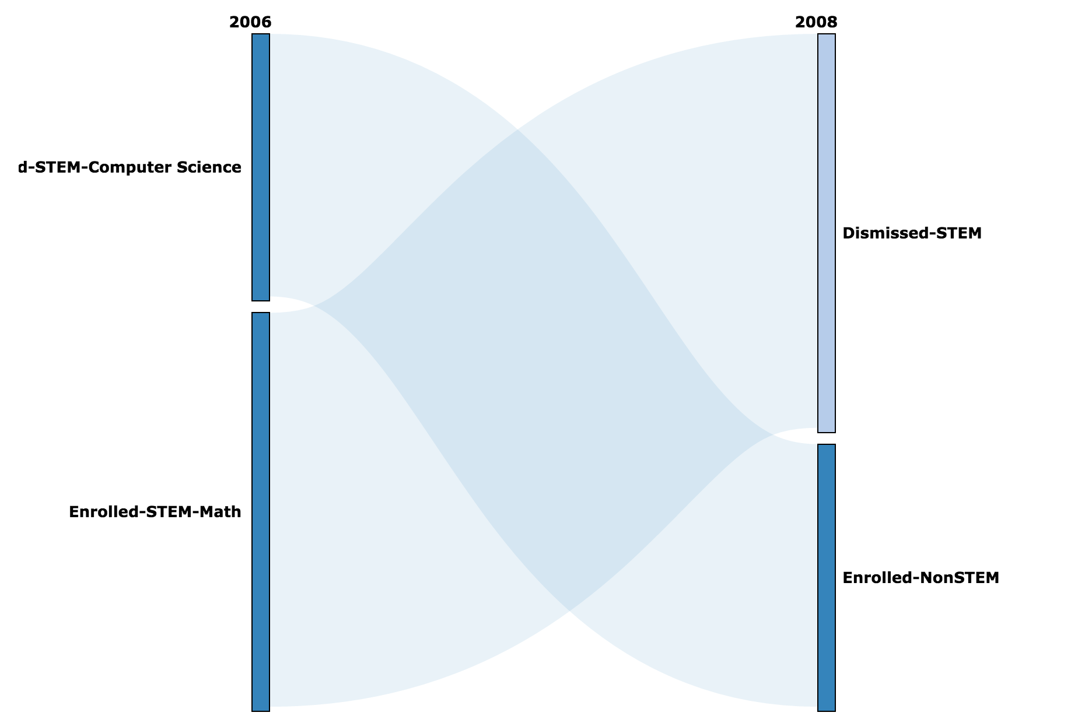
Ribbon Diagram

Slide 6
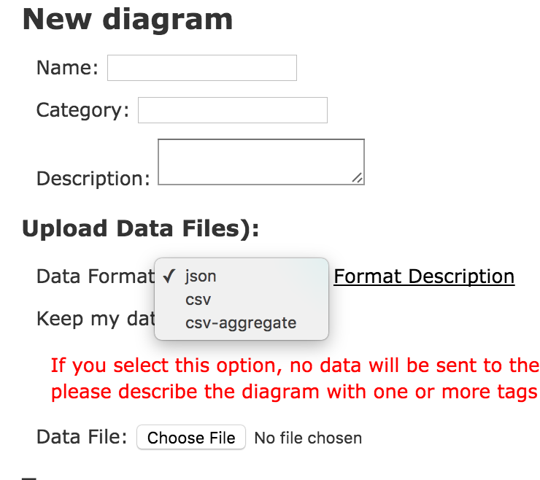
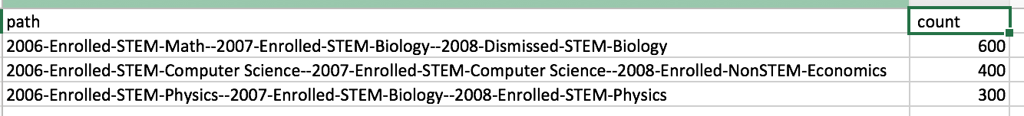
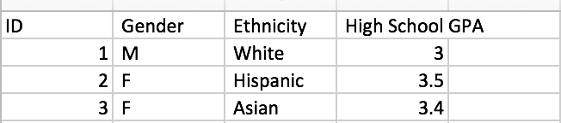
Ribbon
First task we did was to added a new accept format for user input with students’ data.
Before that, we only accept JSON or simple CVS format. We added a new CVS-aggregate format to it.

Slide 7
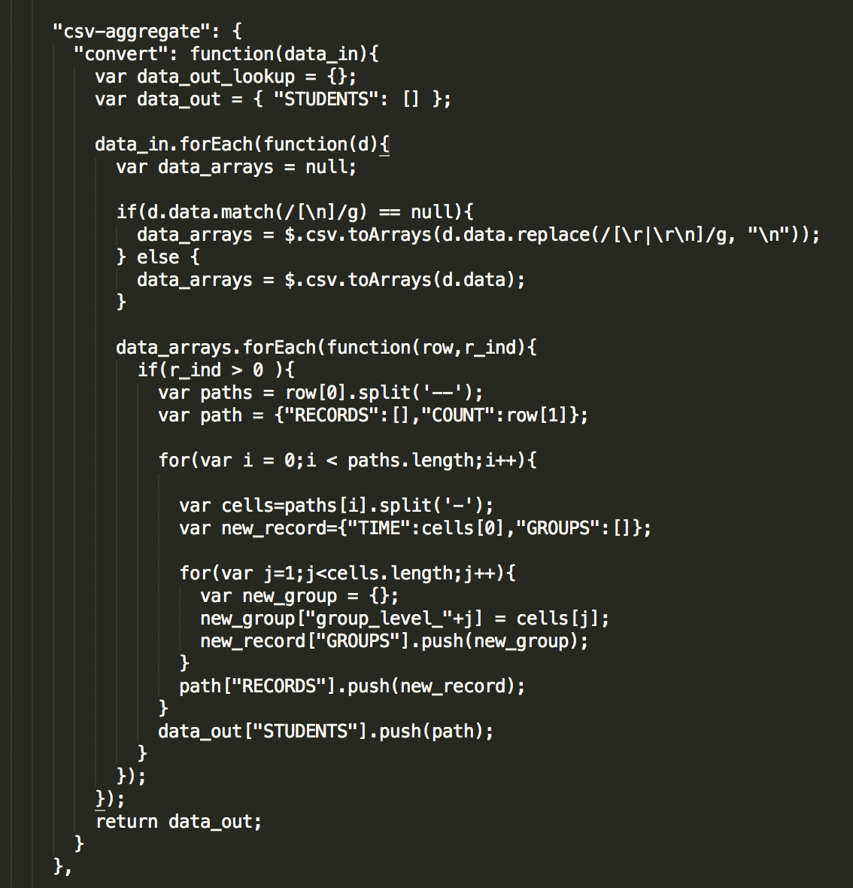
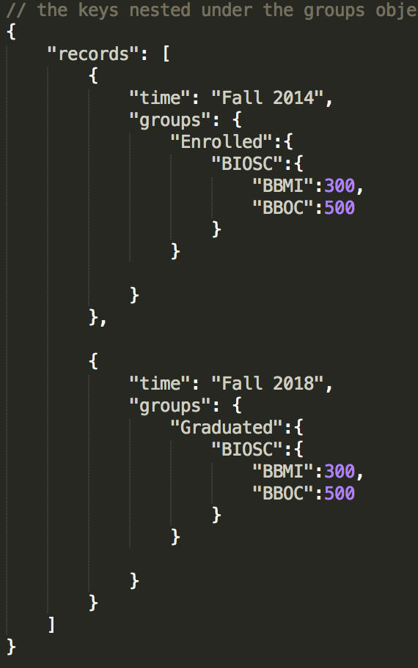
Ribbon
We need to convert those CSV files to a JSON object to draw the graph;
We added a convert function to the _format_converter.js.haml as left side:

Slide 8
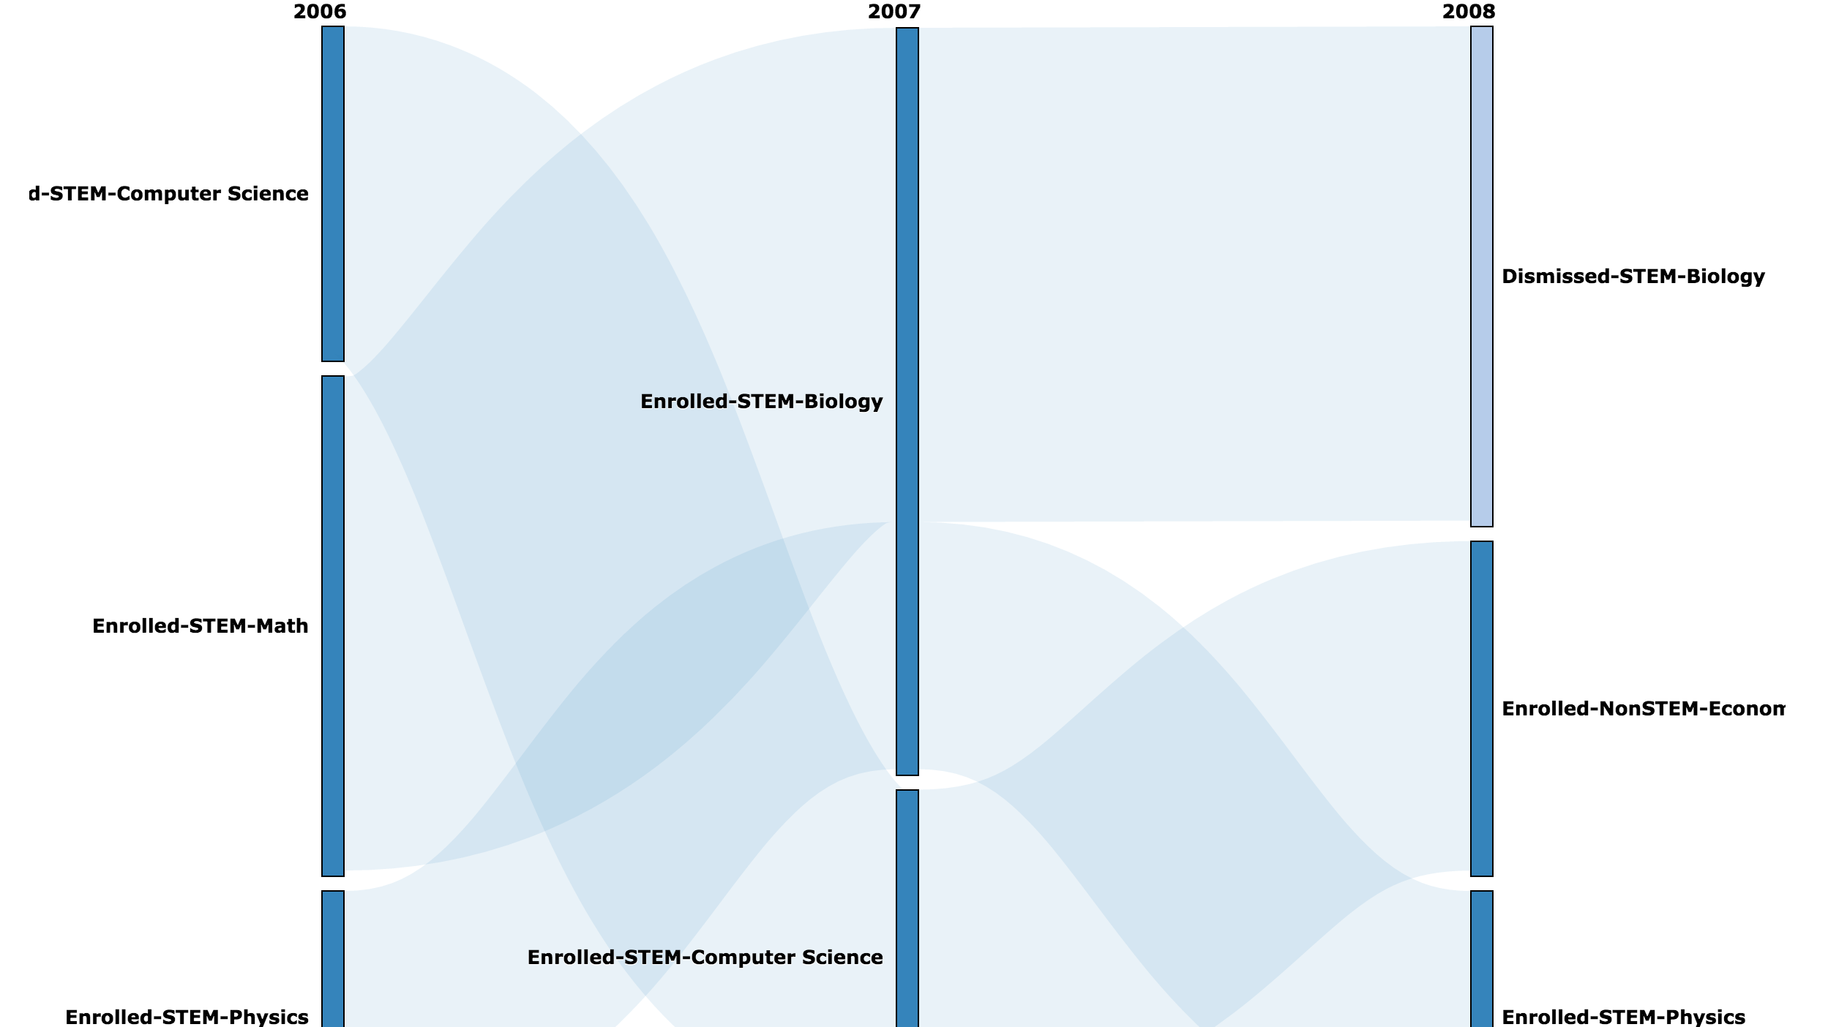
Result:

Slide 9
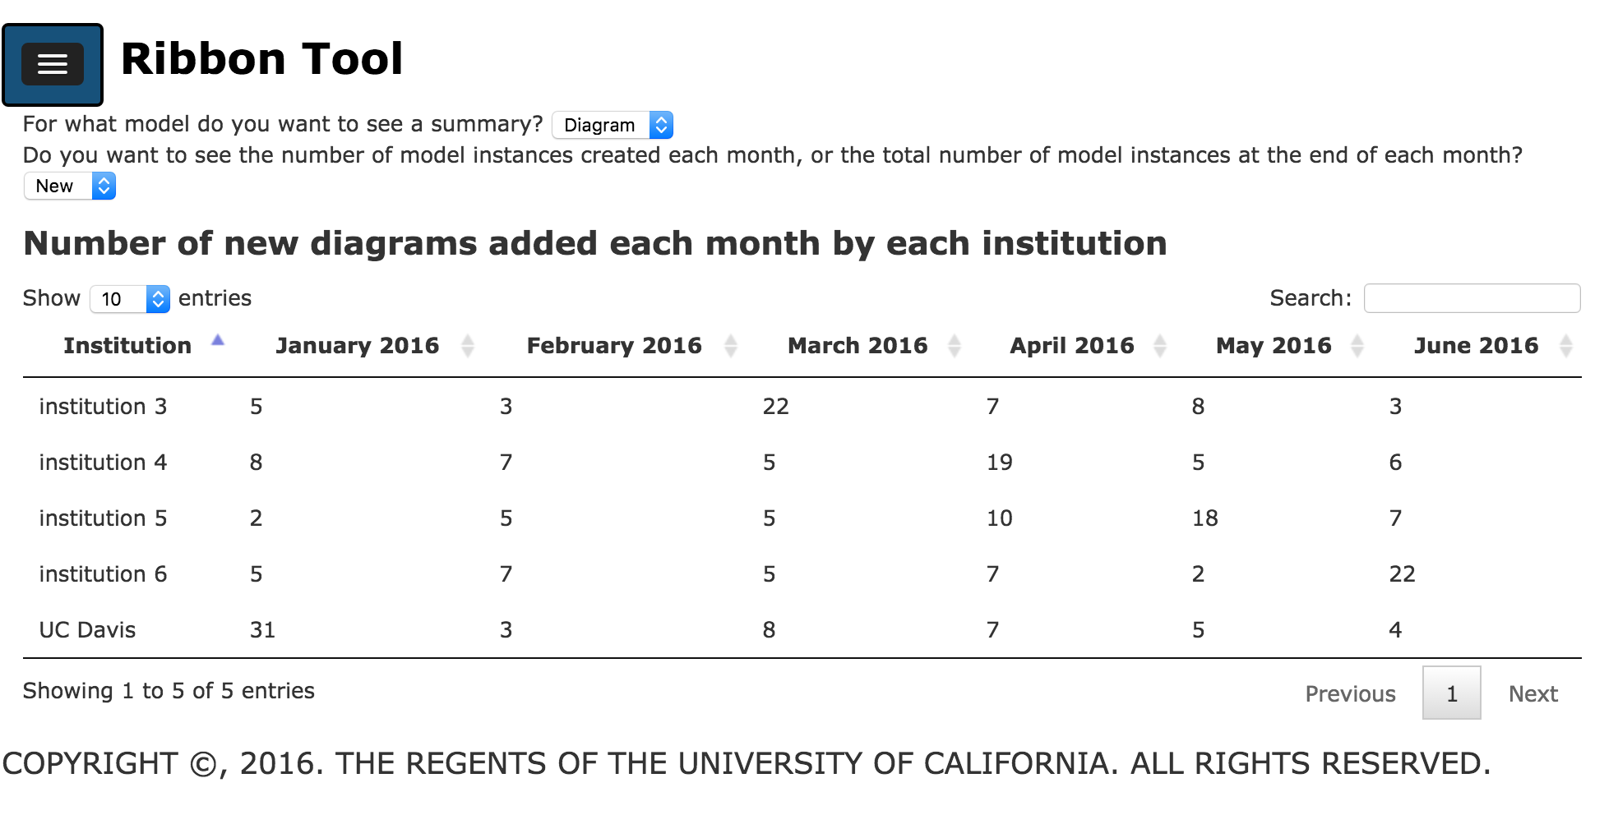
Ribbon
The last thing we did was to add a linear chart to the “/reports” page, which shows how many users or diagrams has been created for each institution each month.

Slide 10
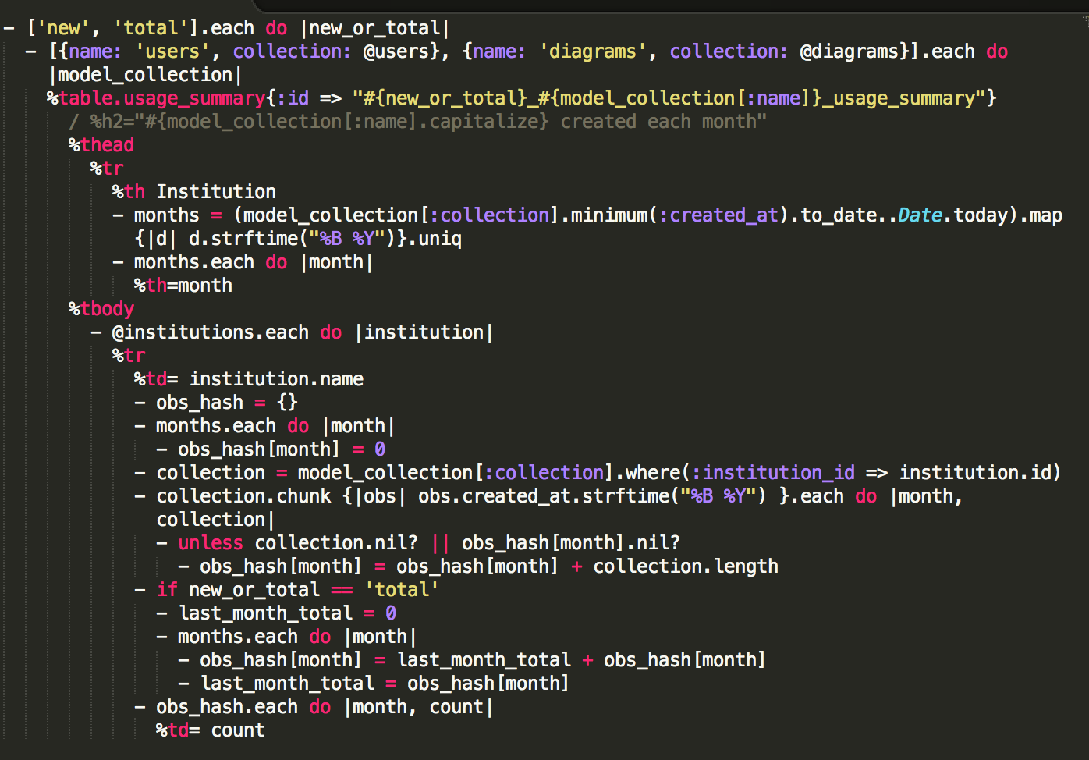
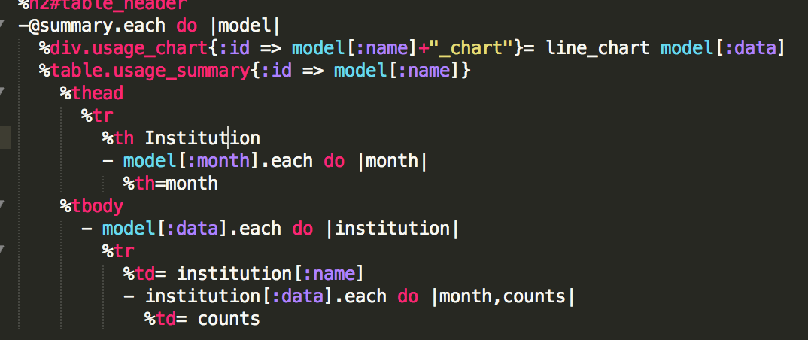
Ribbon
What we did is to modify the reports.html.haml file and the controller file to draw the chart, and we also reconstruct the draw-table code in those files.

Slide 11
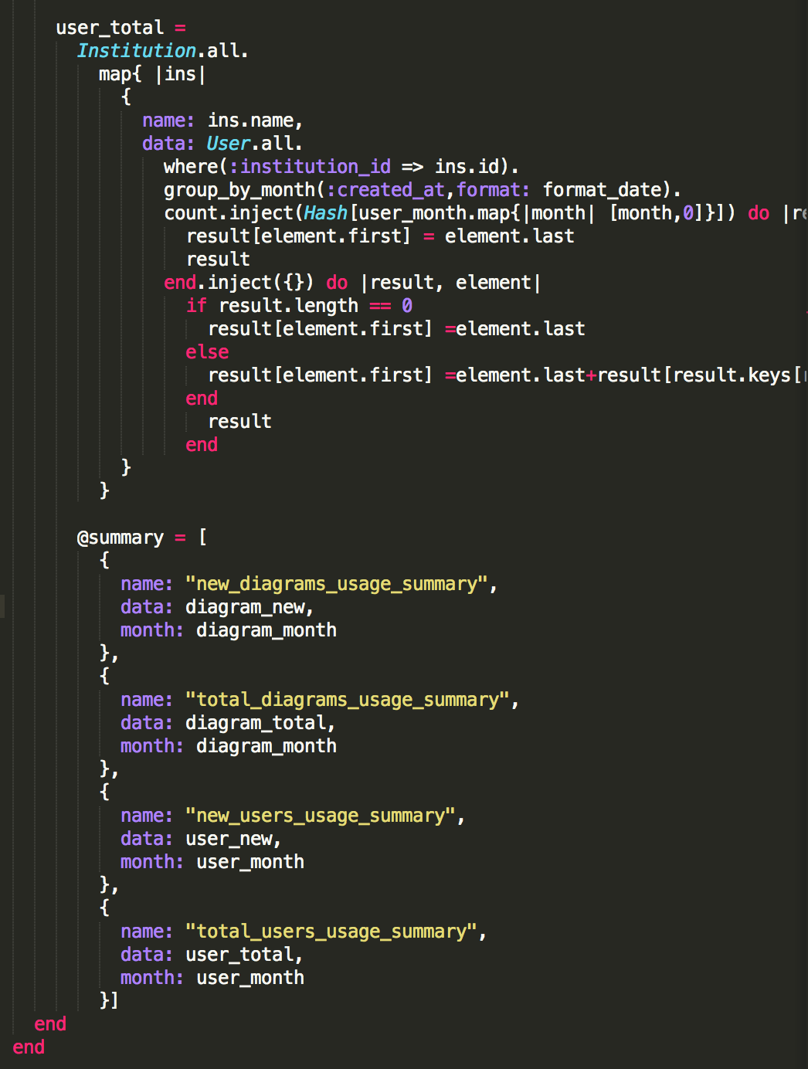
Some code:

Slide 12
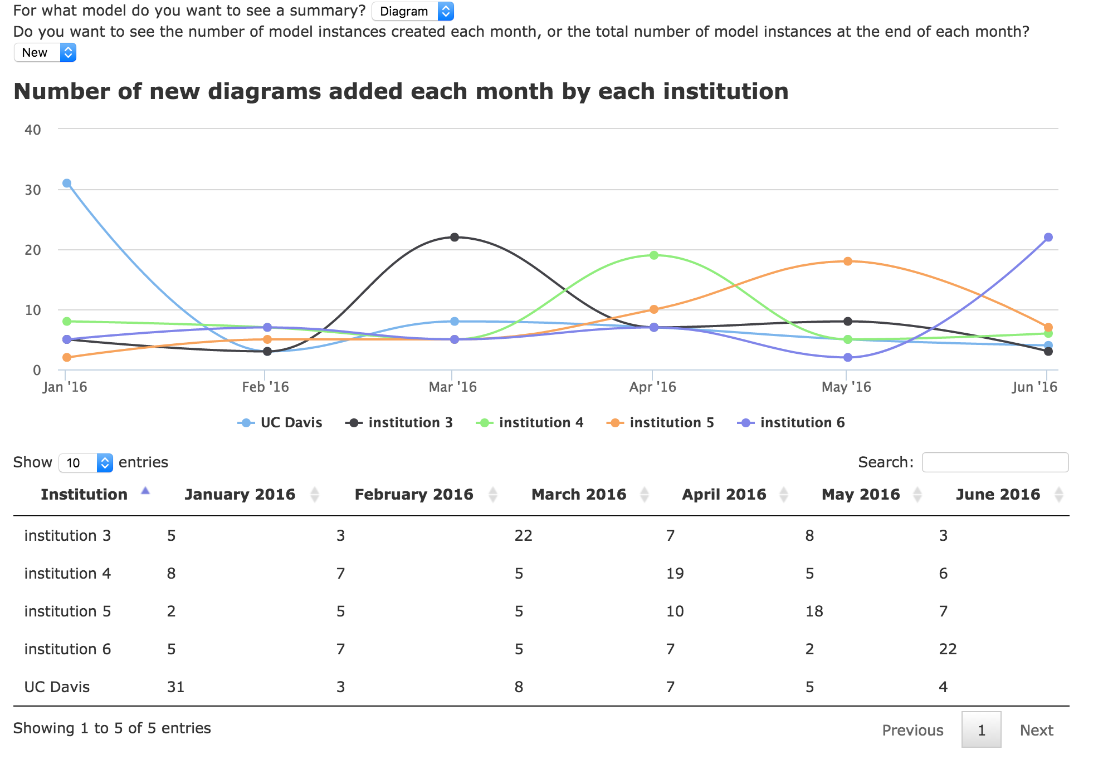
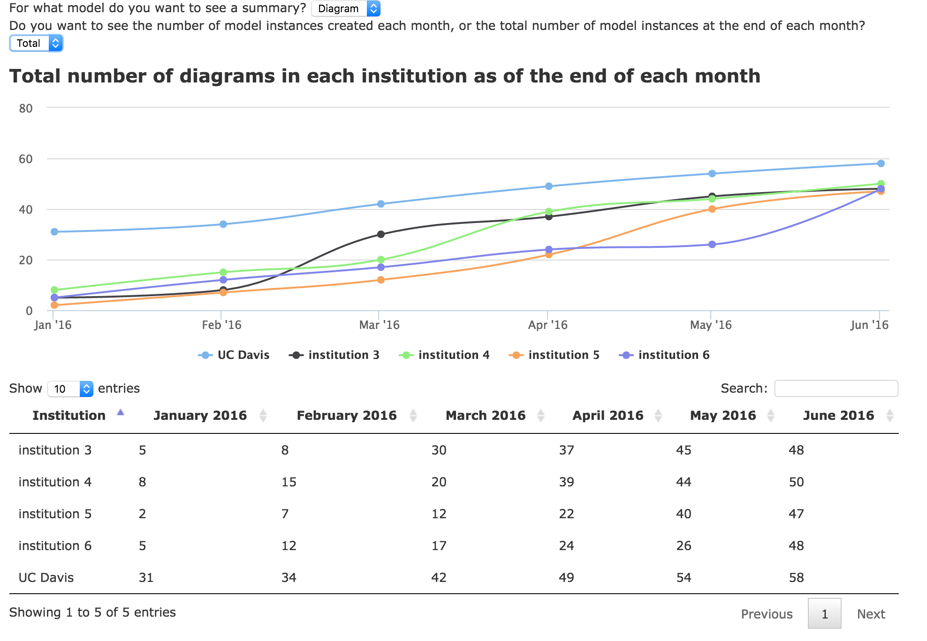
Result:

Slide 13
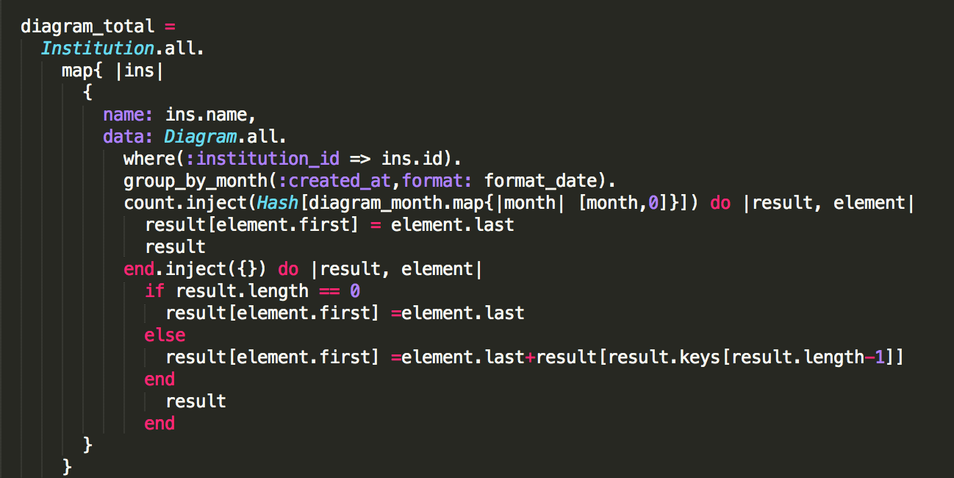
Difficulties:
When I first got this task, I didn’t know where to start, since I am not too familiar with the ruby syntax, and spent lot of time to understand the code.
We found a tool to draw the graph : “chartkick”, it did create some nice graph, but I stocked at how to draw a cumulative graph for total part.
I discussed with Matt several times of the cumulative thing, and finally find a a way to solve it yesterday.

Slide 14
What I learned:
I got familiar with rails application and a little bit ruby syntax.
I also got a chance to know some other useful tools, ex:highchart, chartkick.
Also got more familiar with git, and find it is really useful since I never used git before.
Also learned how to make some fake data for rails.
Learned basic command lines for docker-machine.

Slide 15
Future Plans
I enjoyed working for all kinds of projects, I can learn a lot of things through it. We can also gain lots of real experience during the VIP projects.
I am planning to take this course again next quarter since it is very helpful for me.
I feel that I am more comfortable working with some javascript, and I really felt the difficulty while working the ruby syntax. But it is a good practice, I need to know those strange syntax anyway.

